Slide 1
Creating a Safe & Inclusive Society
Notes:
Making your society safe and inclusive is really important for making sure that your current members have a good experience but also for attracting new members who might otherwise not feel welcome. There are a number of ways to improve the inclusivity and make your society feel like a safe space to a wide range of students.

Slide 2
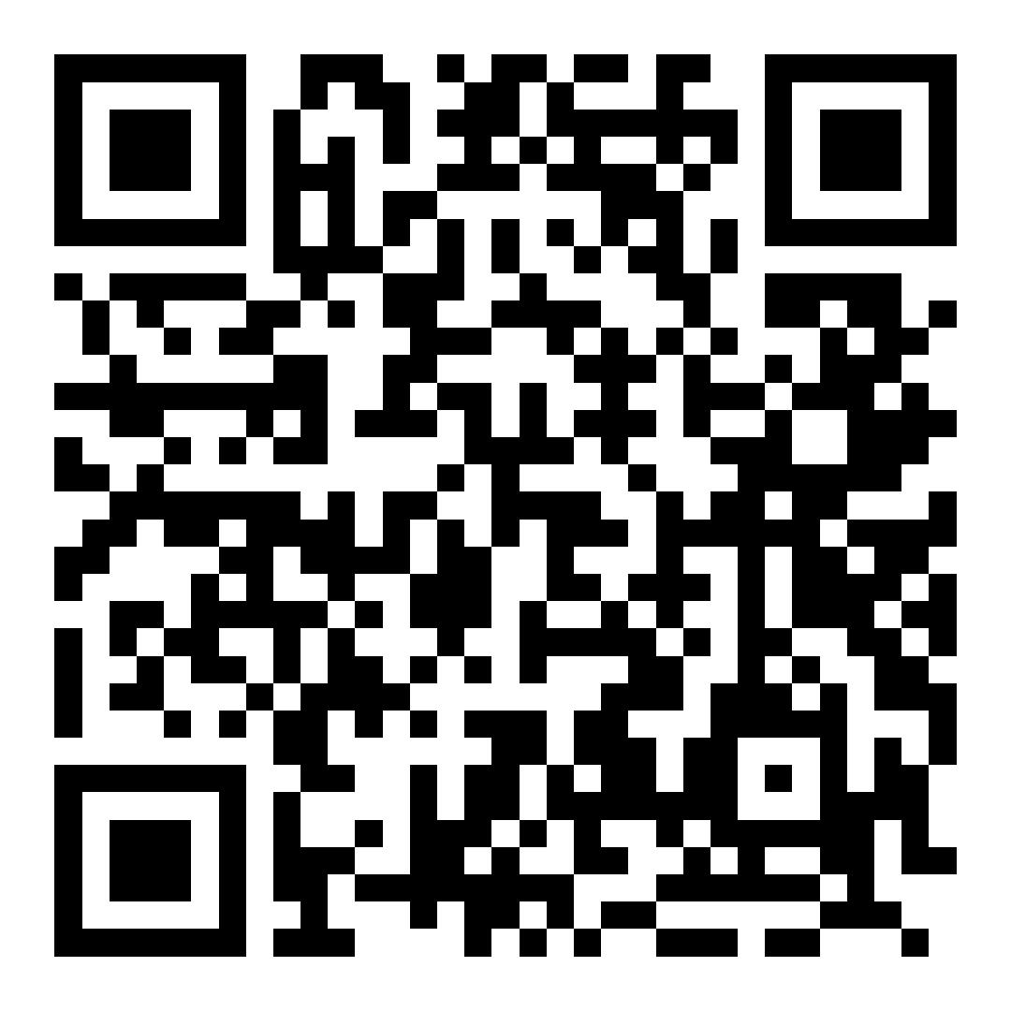
General
Think about non-alcohol based socials
Have a variety of times and days of your events
Diversify your committee and members
Be an ally to your members from underrepresented communities
Listen to your members concerns or worries
Notes:
As well as socials in bars or clubs, make sure you organise events that are not based around alcohol for members who do not drink or are trying to avoid it
Think about varying the times and days of your events so that members who may work or have other responsibilities on one day or time can attend some of your activities
Diversify your committee and members by promoting your society through alternate channels other than your own social media such as the Student Community Facebook Pages or collaborating with the Liberation Campaigns
Be an ally to your members from marginalised communities by learning through SUBU's Allyship Hub and coming along to allyship events run by SUBU and the Liberation Campaigns
Listen to your members concerns or worries - your members will know what they need so listening to them directly is very important.

Slide 3
Financial Support
Increase your low and no cost socials
Split your membership fees up over each term
Include the option for equipment or kit rental
Promote the Club & Society Hardship Fund
Notes:
Increase your low and no cost socials whether it is <insert examples here>
Split your membership fees up over each term so that it is more affordable for your members
Include the option for members to rent equipment or kit rather than needing to buy it outright
Promote the Hardship Fund to members who may need it. This fund can help towards membership fees or being an active member of a club or society they are already a member of

Slide 4
Disabilities, Access Needs and Neurodiverse Students
Host additional or modify sessions for members who require alternative equipment or additional help to complete the activity
Check the accessibility of the venue you are looking to use
Use AccessAble
Include a detailed access statement to your event listings
Notes:
Host additional or modify activities for members who are disabled and require alternative equipment/additional help to complete the activity
Check the accessibility of the venue you are looking to use when doing a site visit if you can
Almost all buildings on Talbot and Lansdowne Campus have a listing on the website AccessAble which show the accessibility of the building and even specific rooms so be sure to add the AccessAble link for your building in the description of on campus events.
Include a detailed access statement to your event listings especially if they are off campus and don’t have an AccessAble listing. Here’s an example of one that was used for a Liberation Network event this year. If you aren’t sure on how to write one Cambridge Student Union has an Access Statement Generator that can help you - https://www.cambridgesu.co.uk/disabled-students-campaign/projects/access-statement/

Slide 5
Disabilities, Access Needs and Neurodiverse Students
Be aware of the nearest disabled toilets
Create a designated quiet space during your events
Think about the accessibility of your social media content
Let your members know they can get a sunflower lanyard or badge from SUBU
Use SUBU's Accessibility Grant
Notes:
If you know an event will be loud or there will be a lot of people attending, make sure you have a designated quiet space for members to utilise when they need it
When posting on your social media channels be sure to think about the accessibility of your content by adding Alt Text to images and captions to videos
SUBU has a stock of sunflower lanyards and badges that students can ask for if they have a hidden disability

Slide 6
Accessibility Grant Funding
You can apply for funding to cover the cost of an activity or equipment that will enable your club or society to be more open and accessible to members who are not able bodied and neurodiverse
 | What is likely to be awarded | What is unlikely to be awarded
SUBU Accessibility Grant | Equipment Activity Insurance Kit | Personal items Marketing Retrospective payments
Notes:
Use SUBU's Accessibility Grant to cover the cost of an activity or equipment that will enable your club or society to be more open and accessible. You can apply for this grant using the same system you would for any other but do be aware there are limitation on what you can use the grant for.
Find out more here: https://www.subu.org.uk/involved/clubs_societies/committeezone/clubsfunding/

Slide 7
Trans and Non-Binary Students
Use pronouns in introductions
Include your pronouns in your screen name for online events
Encourage your committee to wear pronoun badges
Be aware of the nearest Gender Neutral toilets
Notes:
Whenever your committee introduce themselves or if you have a guest for an event, make sure they include their pronouns in their introductions
If you have an online event, get members to add their pronouns to their screen names
Encourage your committee to wear pronoun badges to Freshers Fair and society events – we have brought some with us today so do pick one up after this session!
Similar to being aware of the nearest Disabled toilet, make sure you are aware of the nearest Gender Neutral toilets are and let you members know at the start of the session

Slide 8
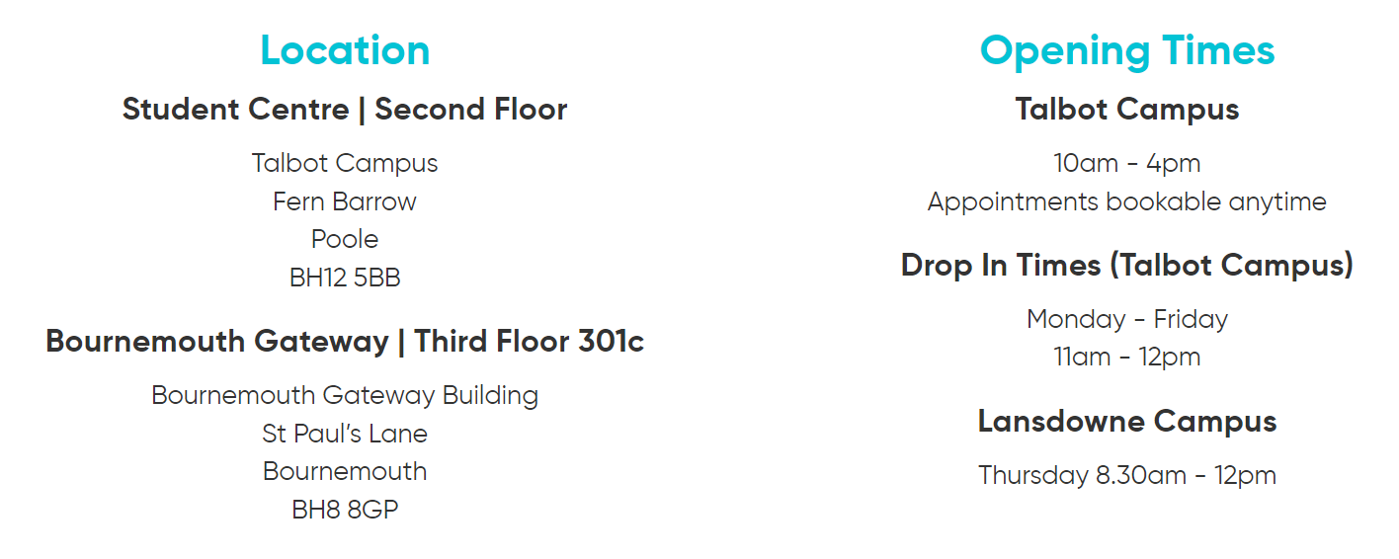
Mental Health
Add a mental health champion to your committee member roles
Take part in Mental Health First Aid Training
Make sure to guide members to SUBU Advice if needed
Notes:
Add a mental health champion to your committee member roles
The Student Opportunities team organise Mental Health First Aid Training throughout the year so be sure to take part when they do
Make sure to guide members to SUBU Advice if needed, while you may be their society committee there will be many things you cannot sort on your own and SUBU Advice is there to help. More info here: https://www.subu.org.uk/support/advice/

Slide 9
Sexual Harassment and Violence
SUBU believes that sexual misconduct, harassment and violence are #NeverOK and so as SUBU Clubs & Societies we hope you do to.

Slide 10
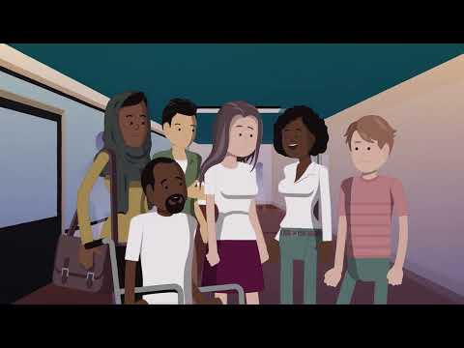
Sexual Harassment and Violence

Slide 11
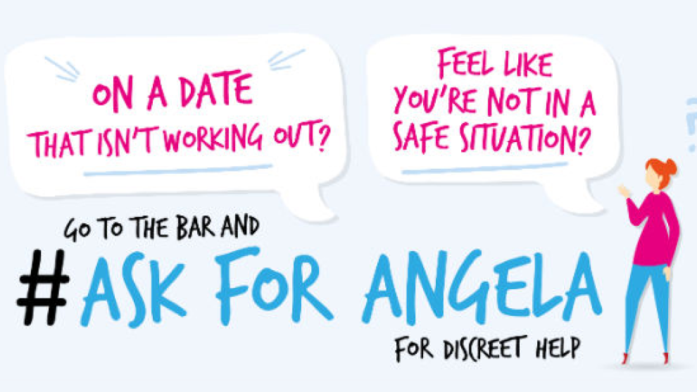
Sexual Harassment and Violence
SUBU believes that sexual misconduct, harassment and violence are #NeverOK and so as SUBU Clubs & Societies we hope you do to.
Ensure your members are aware of SUBU's initiatives to help keep you safe while out:
Ask for Angela
Safe Taxi Scheme
Spiking prevention
STARS Dorset which provides support for those who have experiences sexual assault or rape at any time in their lives, have drop-in sessions on Talbot Campus on the first Monday of the month
Find more info on reporting, local support services and these initiatives at subu.org.uk/neverok
Notes:
As well as this, ensure your members are aware of SUBU's initiatives to help keep you safe while out:
Ask for Angela – You may have heard of this scheme before but if you feel unsafe, vulnerable or threatened while in any SUBU venues (The Student Centre, The Old Fire Station & Dylan's), you can discreetly ask for help from venue staff by asking them for 'Angela' and they will assist you. You can identify venue staff by their lanyards or branded t-shirts
Safe Taxi Scheme – If you are out of money on a night out and need to get home safely? SUBU’s Safe Taxi scheme can help you get home safe after a night out without you having to worry about having to pay straight away for your ride. We have handy business cards with the instructions on how to access the schemes which you can pick up form the front at the end of the session.
Spiking prevention - You can collect spikeys from the bar at the Old Fire Station or SUBU reception which you can put in the top of bottles on nights out. The Old Fire Station also have spiking test kits available too.
It is also important to know about local organisations that support survivors of sexual assault or rape like STARS Dorset who have drop-in session on Talbot Campus on the first Monday of each month during term time.
You can also find out about how to report incidents at subu.org.uk/neverok

Slide 12
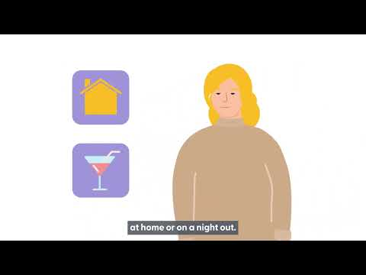
Drink spiking

Slide 13
Drink spiking
What to do if you think you or a friend have been spiked
Tell a bar manager, bouncer or member of staff
Stay with them and keep talking to them
Call an ambulance if their condition deteriorates
Don’t let them go home on their own
Don’t let them leave the venue with someone you don’t know or trust
If possible, try and prevent them drinking more alcohol as this could lead to more serious problems

